Slide 1




》》
2
0
1
4
Bit-Scalable Deep Hashing with Regularized Similarity Learning for Image Retrieval and Person Reidentication
Ruimao Zhang, Liang Lin, Rui Zhang, Wangmeng Zuo, and Lei Zhang
IEEE 2015

Slide 2

1
目录
Unsolved Problems
2
Bit-scalable deep hashing framework
3
Learning algorithm
4
Experiments
5
Conclusion

Slide 3
Unsolved Problems
two crucial steps in image retrieval:
extract informative image features
learn effective approximate hashing functions
two problems:
learn hash functions from a predefined hand-crafted feature space----------the feature representation may not be tailored to the objective of hashing learning.
the bit lengths of output hashing codes are preset--------different scenarios often require hashing codes of different lengths.

Slide 4
Solution
The convolutional neural network (CNN) is utilized to build the end-to-end relation between the raw image data and the binary hashing codes for fast indexing.
Each bit of these output hashing codes is weighted according to their signiﬁcance.

Slide 5
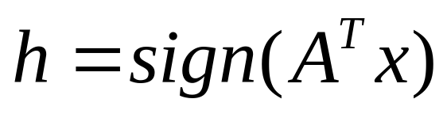
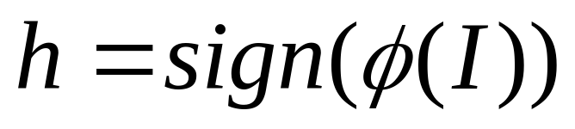
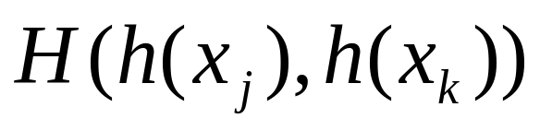
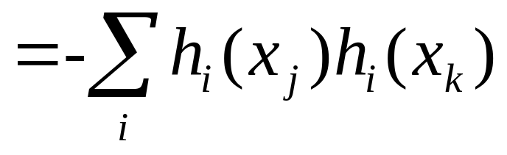
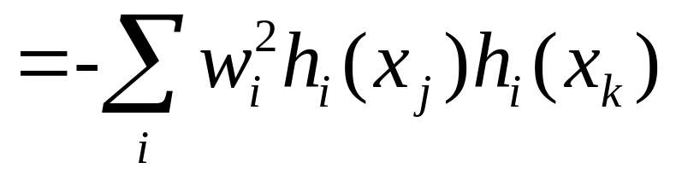
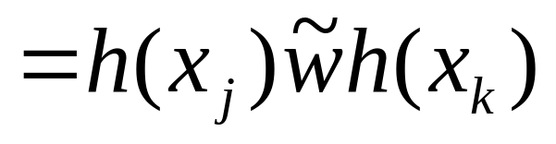
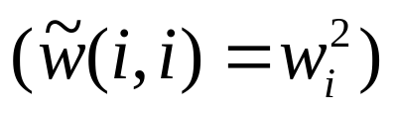
Bit-scalable deep hashing framework
Traditional
Weighted

Slide 6
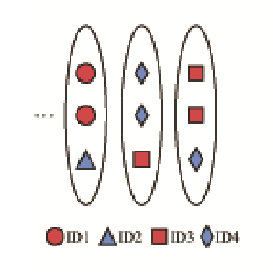


Bit-scalable deep hashing framework
triplet units：

Slide 7
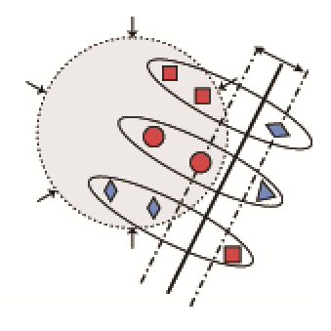

Formulation
Deﬁne a Max-Margin term embedded in the Hamming space to maximize the margin between the matched pairs and the mismatched pairs.

Slide 8


Formulation

Slide 9




Formulation：relation on original space

Slide 10

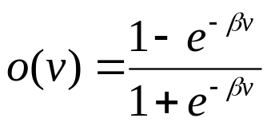







Objective

Slide 11
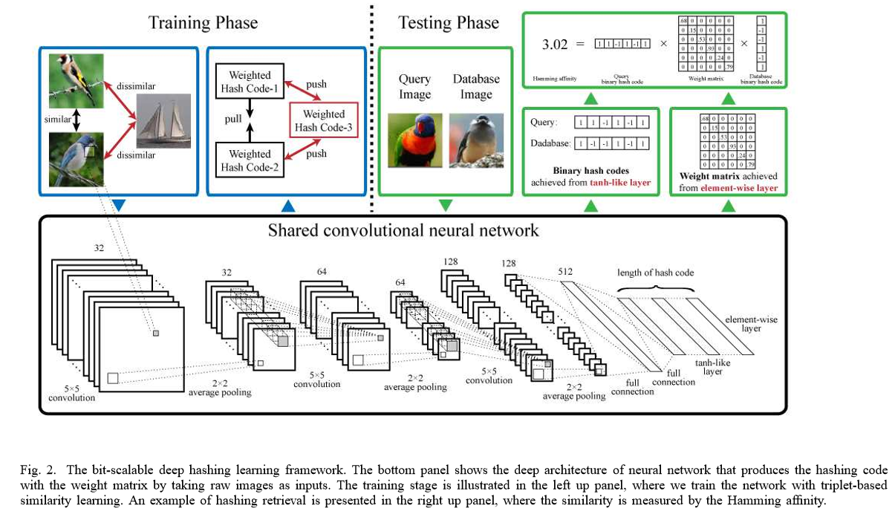
Deep Architecture

Slide 12
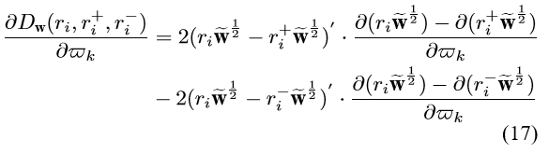






Learning algorithm
(1) forward propagation:calculate for a certain image ;
(2) backward propagation:calculate ;
(3) calculate each corresponding to by Eq.(17);
(4) summing the gradient according to Eq.(15).

Slide 13
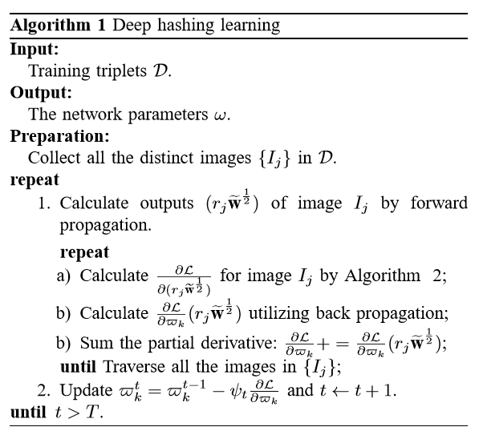
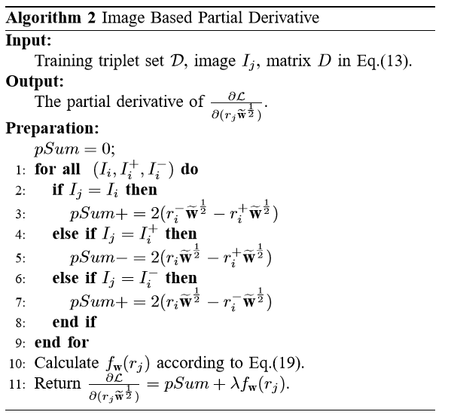

Learning algorithm

Slide 14
Experiments
DRSCH: Deep Regularized Similarity Comparison Hashing( no element-wise layer )
DSCH: no the Laplacian regularization term ( no element-wise layer )
BS-DRSCH: bit-scalable versions of DRSCH
BS-DSCH: bit-scalable versions of DSCH
unsupervised: LSH、SH、ITQ、PCA-RR
supervised: MLH、BRE、KSH、DSRH

Slide 15
Experiments：MNIST
70K greyscale handwritten digital images from ”0” to ”9”
each image has 28 × 28 pixels
10K images as the query set
the other 60K as the training samples

Slide 16
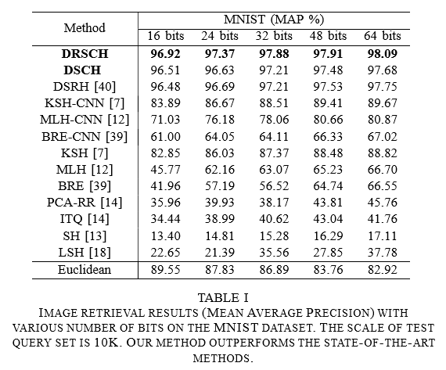
Experiments：MNIST

Slide 17
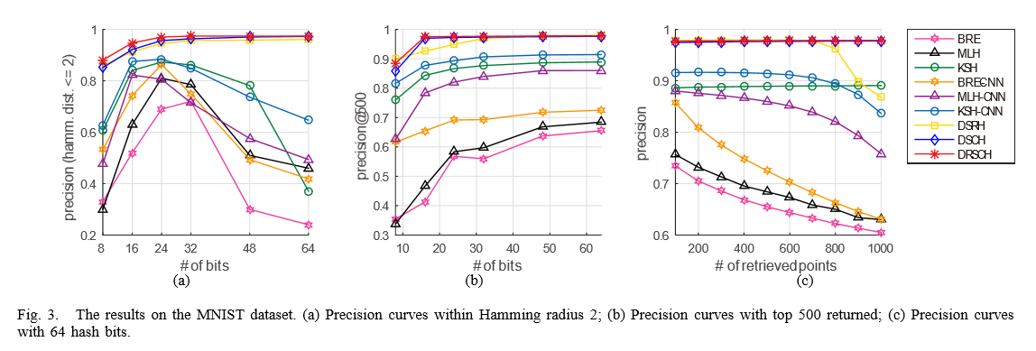
Experiments：MNIST

Slide 18
Experiments：CIFAR-10
60K 32×32 color images from 10 classes, with 6K images per class.
randomly sample 10K query images (1K images per object class) and use the rest as the training set.

Slide 19
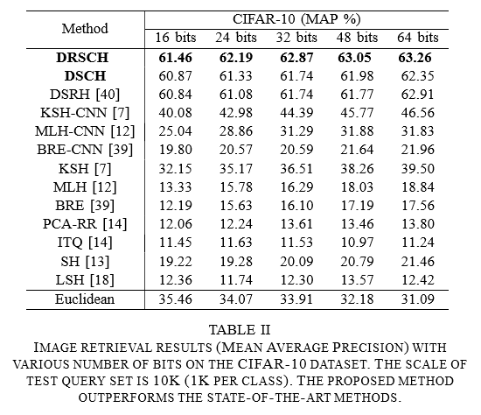
Experiments：CIFAR-10

Slide 20
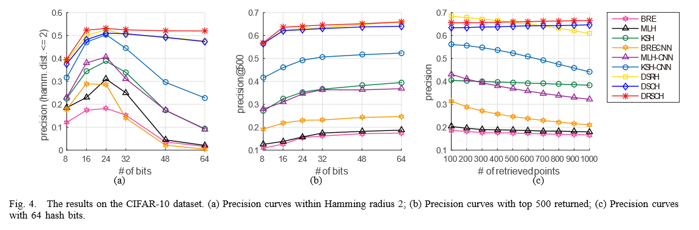
Experiments：CIFAR-10

Slide 21
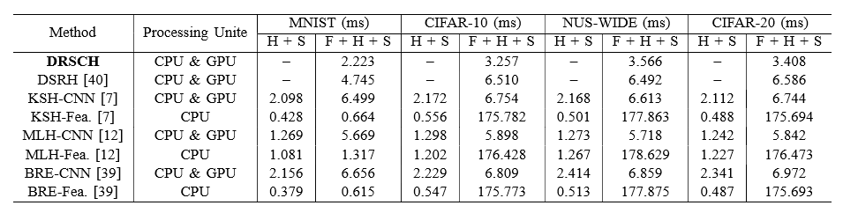
Experiments：Efficiency
NVIDIA Tesla K40 GPU,
Intel Core i7-3960X
3.30GHZ CPU
24GB memory.

Slide 22
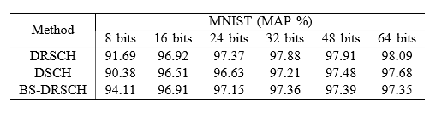
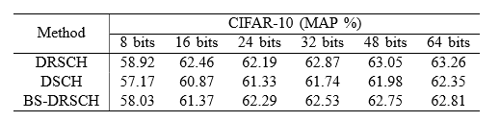
Evaluation of Bit-Scalable Hashing

Slide 23
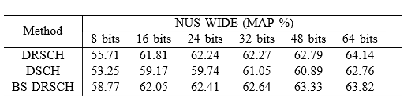
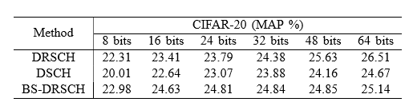
Evaluation of Bit-Scalable Hashing

Slide 24
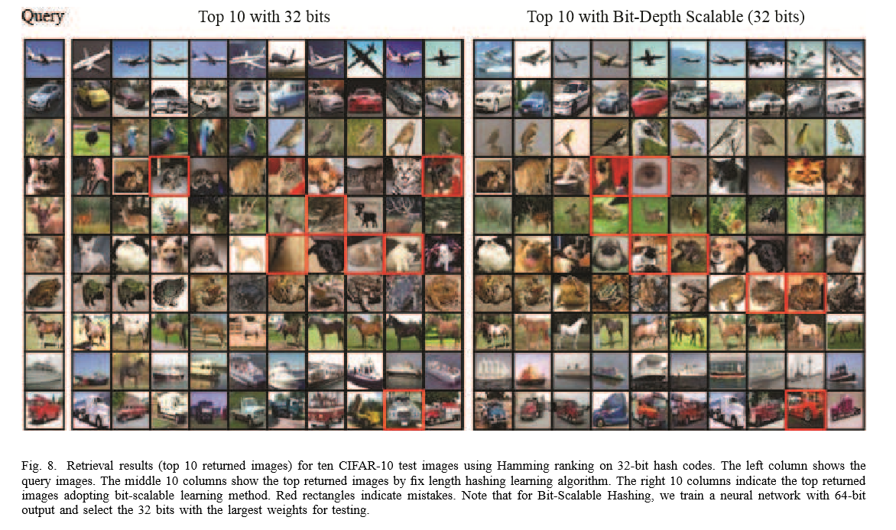
Evaluation of Bit-Scalable Hashing

Slide 25
Application to Person Re-Identification
CUHK03:
13164 images of 1360 pedestrians collected from 6 different surveillance cameras.
training set (1160 persons), validation set (100 persons) and test set (100 persons).
Cumulative Matching Characteristic(累积匹配特性):在目标图库前n个最相似候选目标内找到探测图片正确匹配的概率。

Slide 26
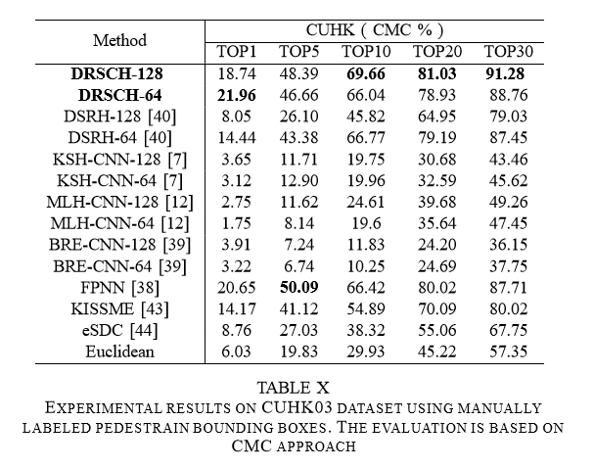
Application to Person Re-Identification

Slide 27
Conclusion
i) it uniﬁes feature learning and hash function learning via deep neural networks.
ii) it presents a novel formulation (i.e., the regularized triplet-based comparison) for hashing learning.
iii) the learned hashing codes well preserve the instance-level similarity.

Slide 28
谢谢观看

